Slide 2
FarmFresh
Danielle Rowe
4th year, Computer Science & Experience Design
ARTG 2400 Spring 2021

Slide 3
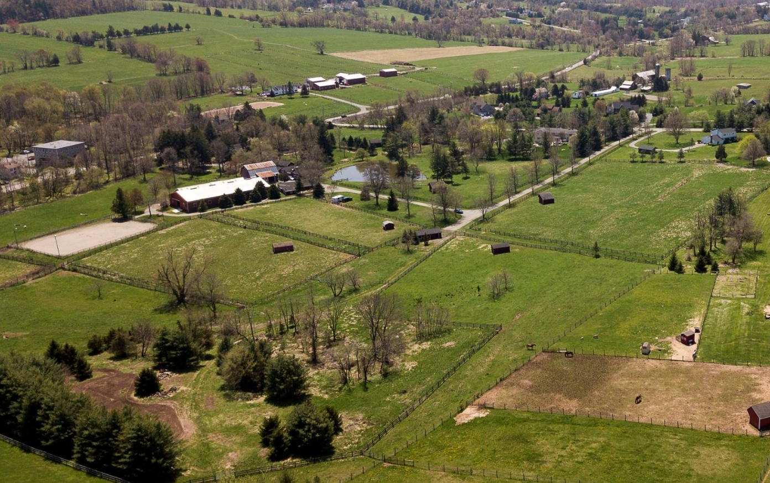
The Problem - Users
The Inspiration:
Location - Rural
Small Farms
Farmer’s Markets
Road Stands
The Users:
Farmers
Artisans
Families
Notes:
Describe your hometown, farm stands, pandemic effect
Describe users and your perspective
Who are the primary users (roles)
ii.What do they want to do (tasks)
iii.Why do they want to do it (goals)
iv.How do they go about doing it (workflows)
v.What is getting in their way (pain points)

Slide 4
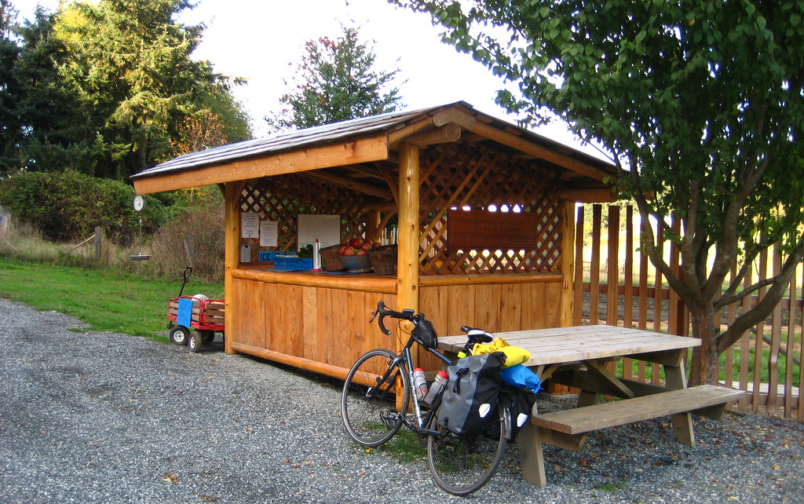
The Problem - Tasks
The Tasks:
Advertise Farm Stand
Find fresh produce
"Ruckle Farm Stand" by WireLizard is licensed with CC BY 2.0. To view a copy of this license, visit https://creativecommons.org/licenses/by/2.0/
Notes:
Two groups - sellers and customers

Slide 5
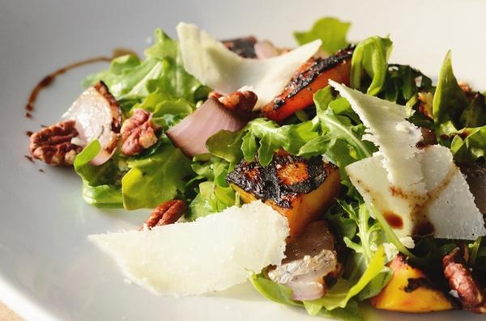
The Problem - Goals
The Goals:
Make a profit
Cook healthy food

Slide 6
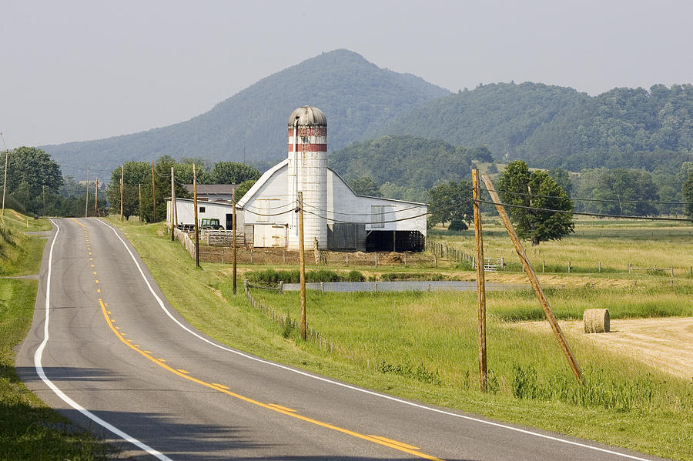
The Problem - Workflows and Pain Points
The Workflows:
Set up stand, operate
Driving and markets
The Pain Points:
Location
Crowds
Uncertainty

Slide 7
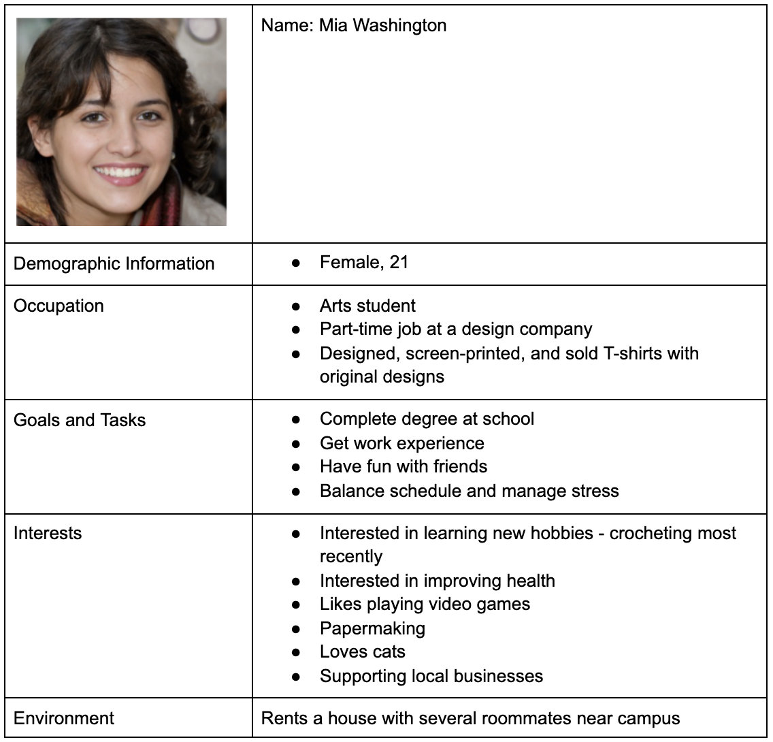
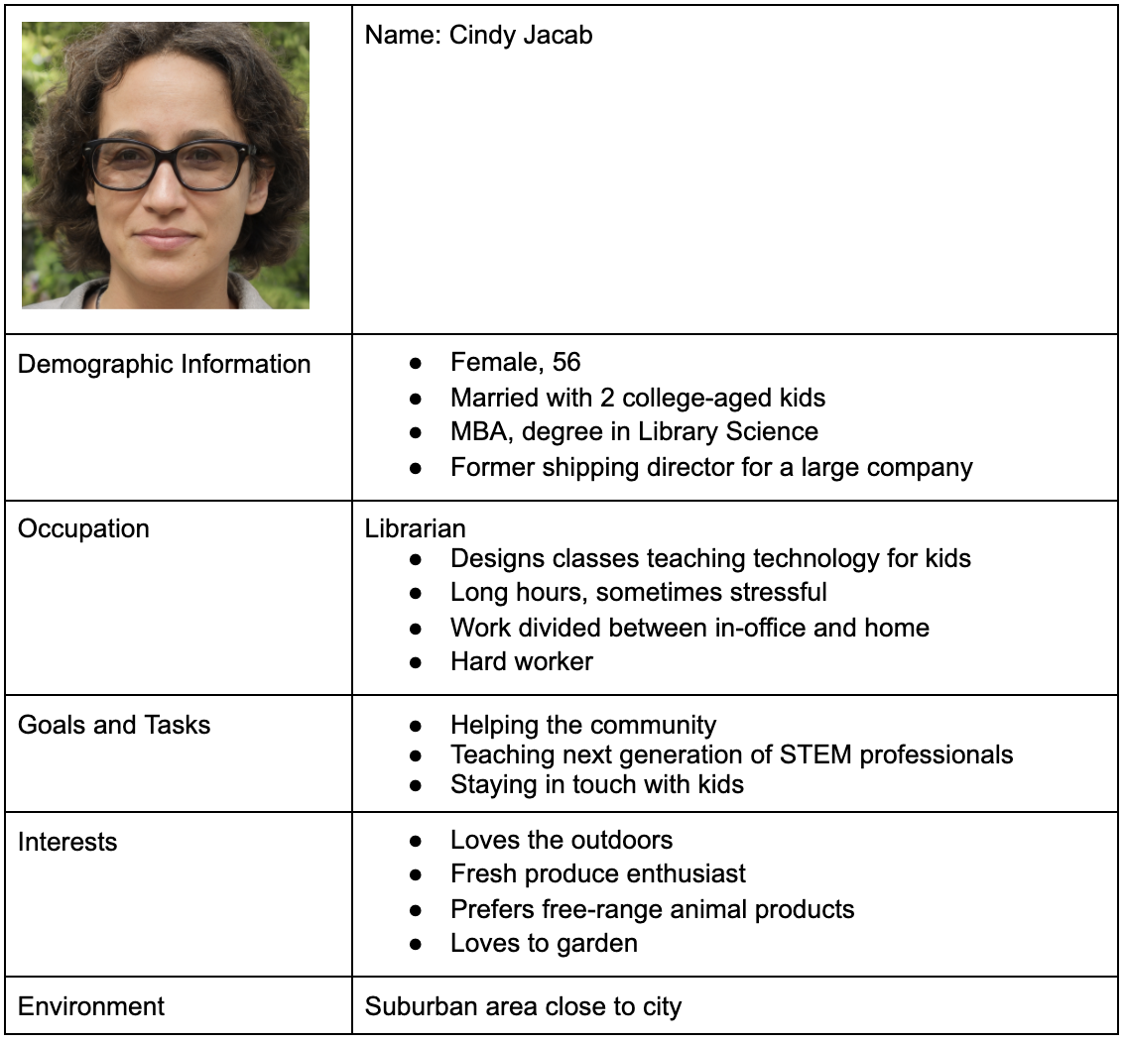
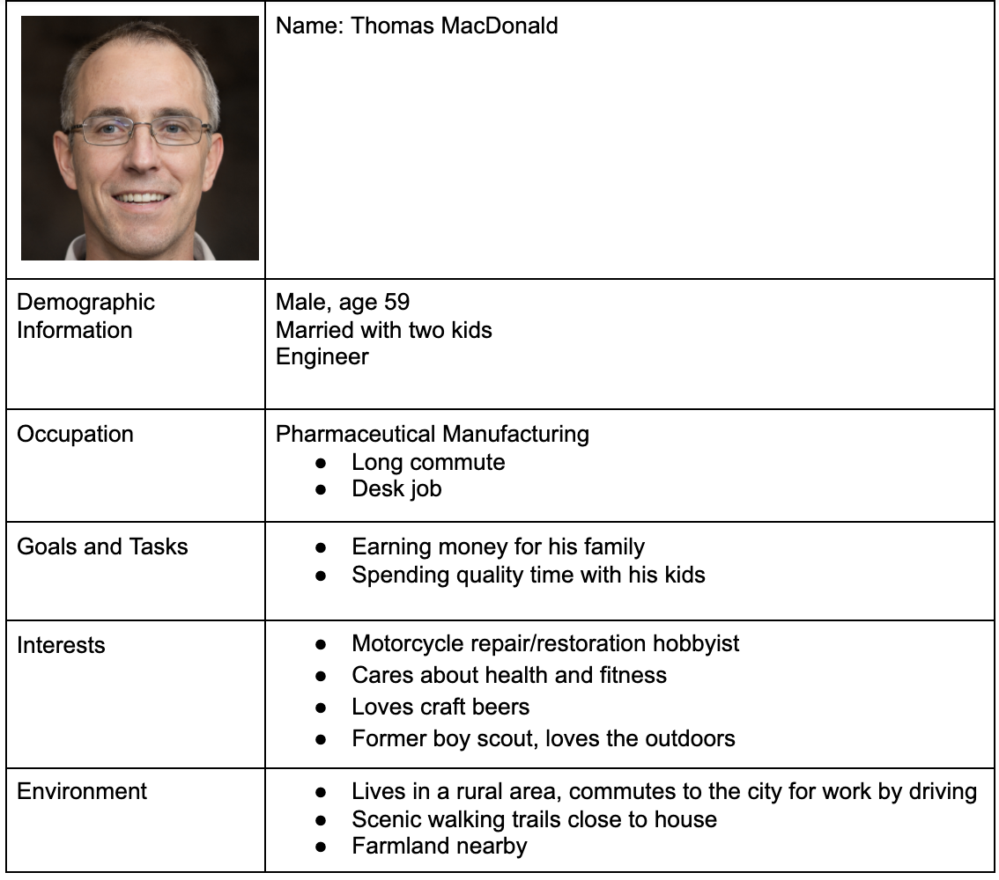
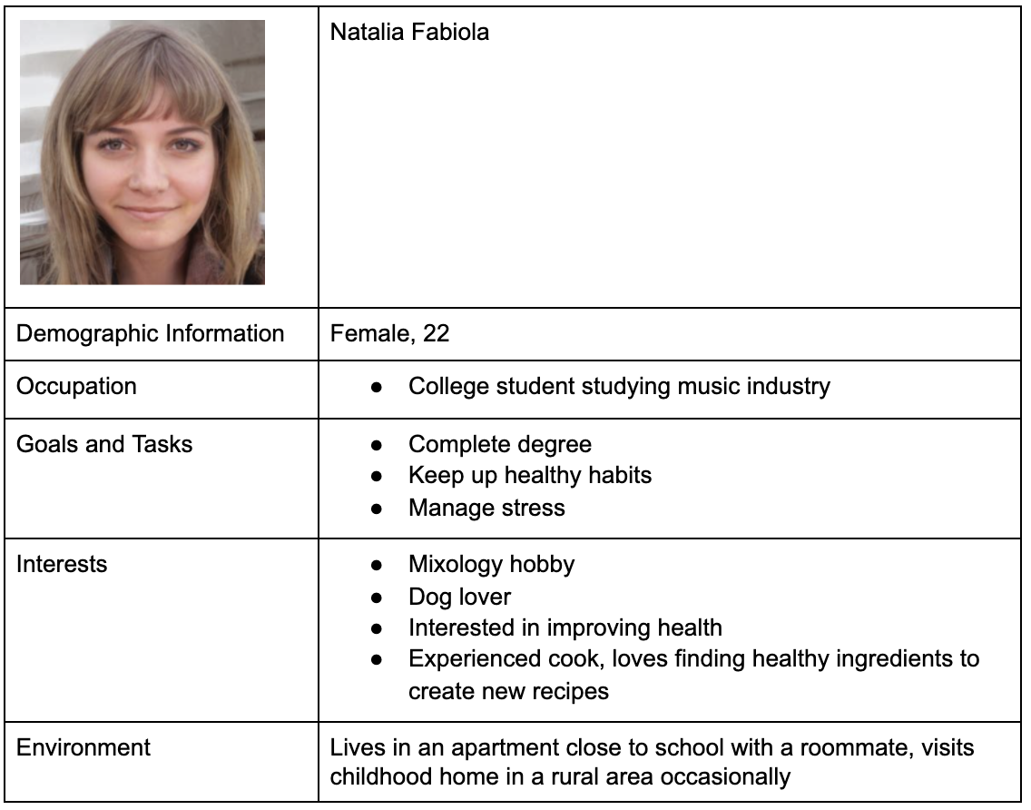
The Process - Personas and User Interviews
Personas:
Original brainstorming
Based on people I would interview
Rough ideas and details

Slide 8
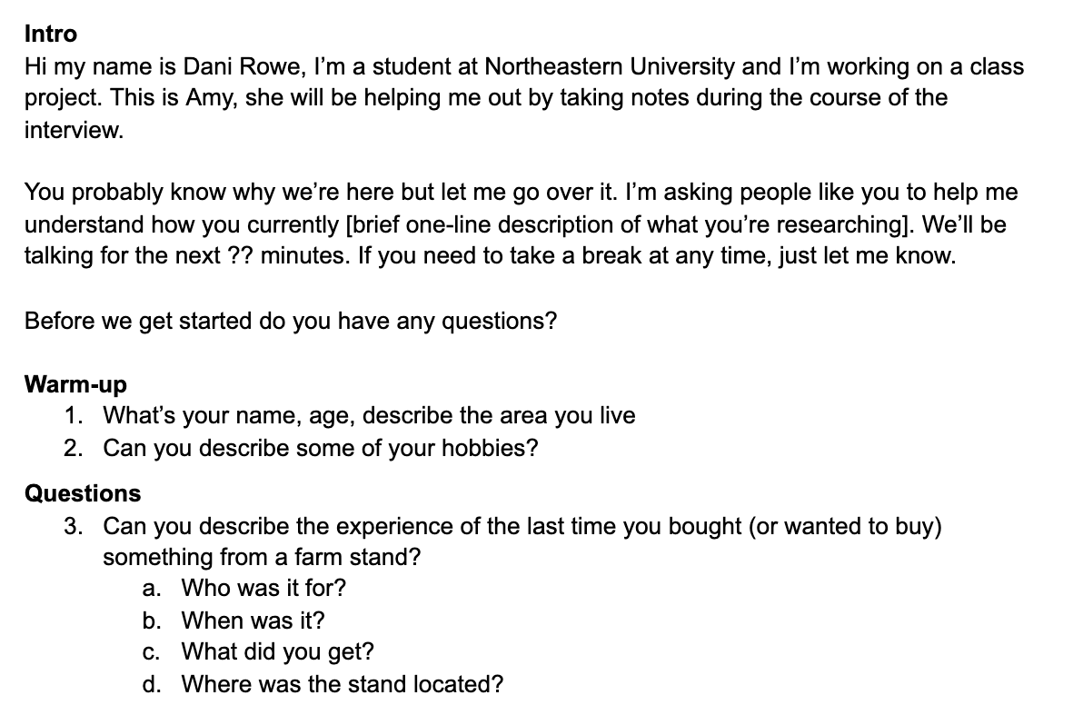
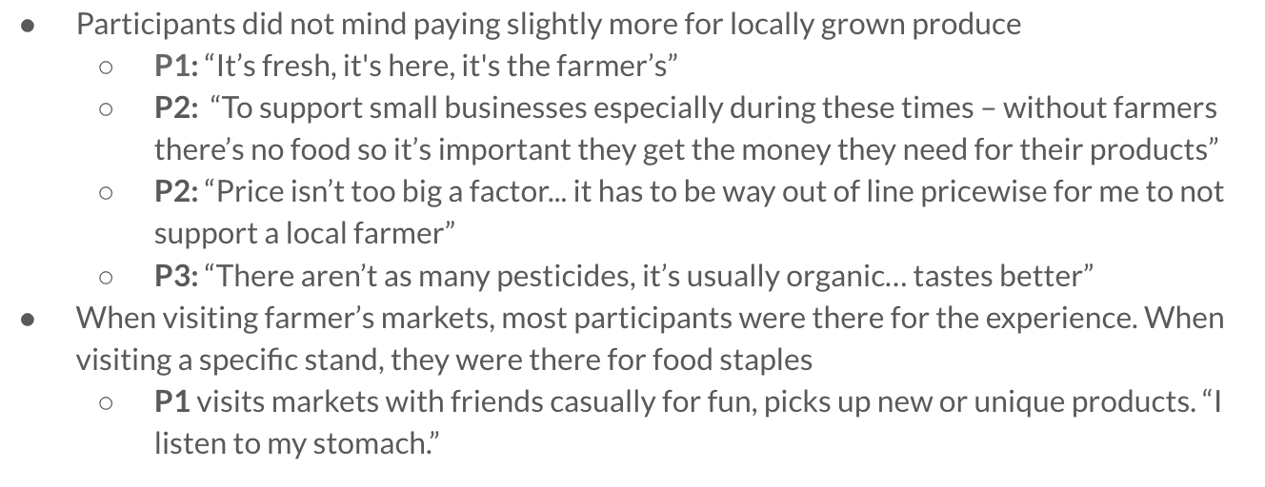
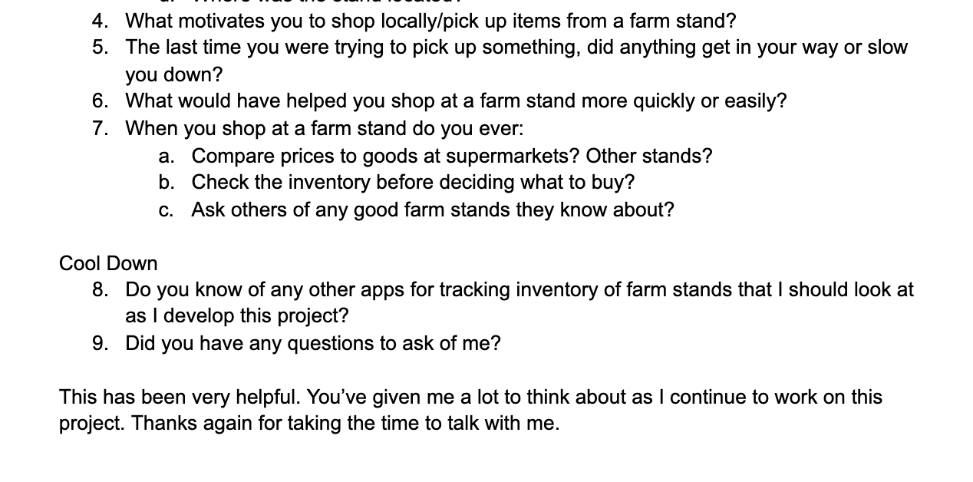
The Process - Personas and User Interviews
User Interviews:
Over Zoom
Excellent insights
Concrete examples

Slide 9
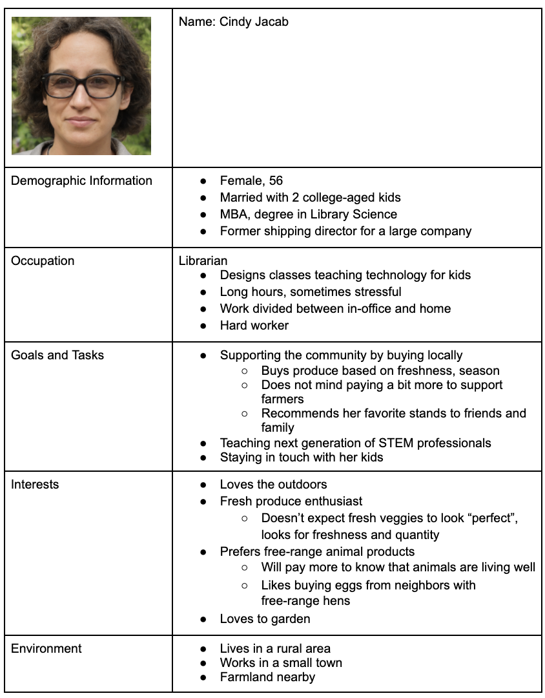
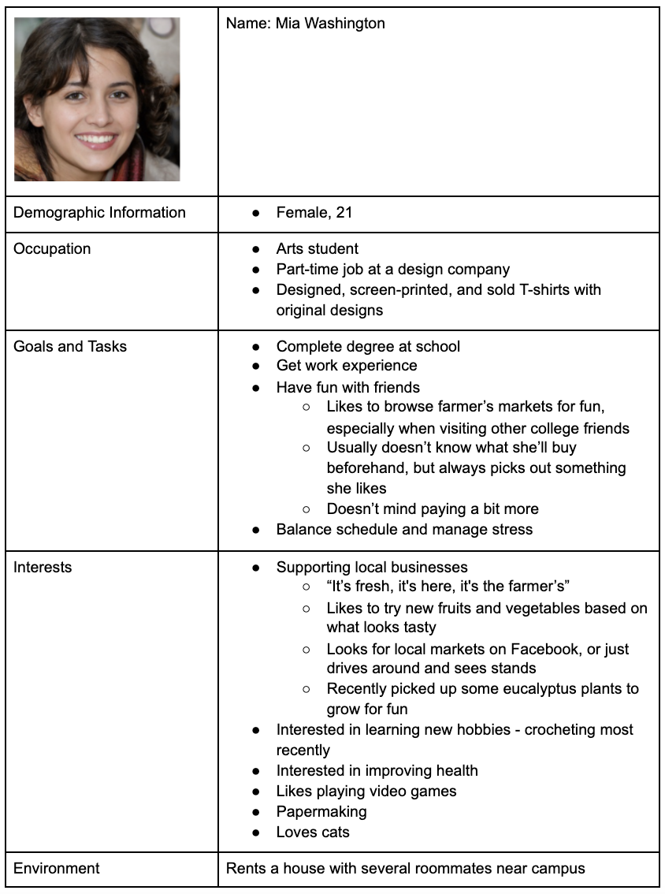
The Process - Personas and User Interviews
Updated Personas:
Better understanding of users
More use cases
New information

Slide 10
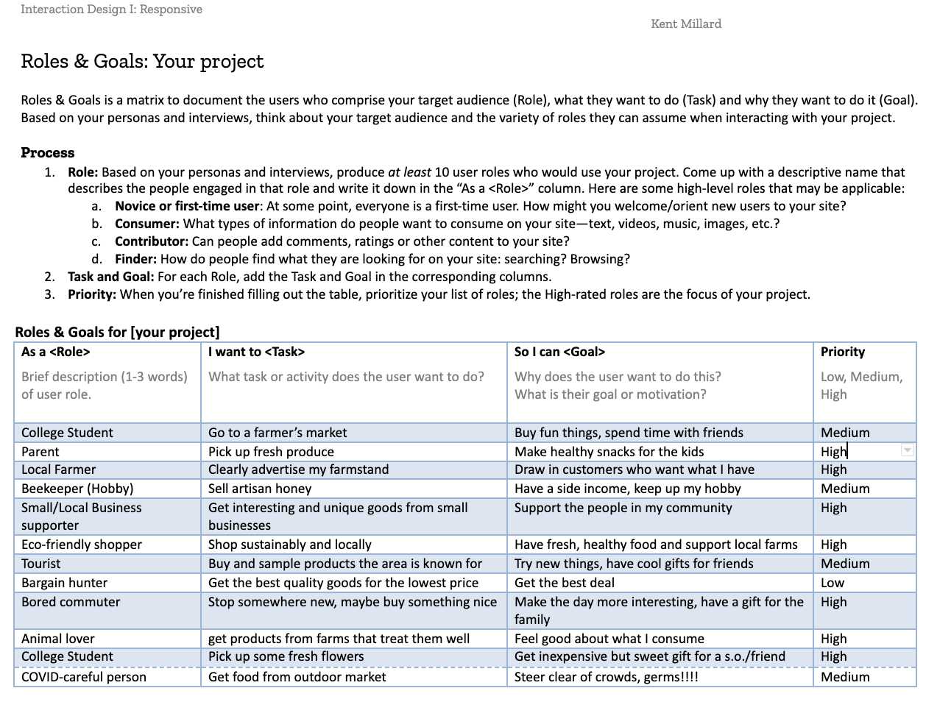
The Process - Roles and Goals
Brainstorming users
Find motivations and reasons to use the product

Slide 11
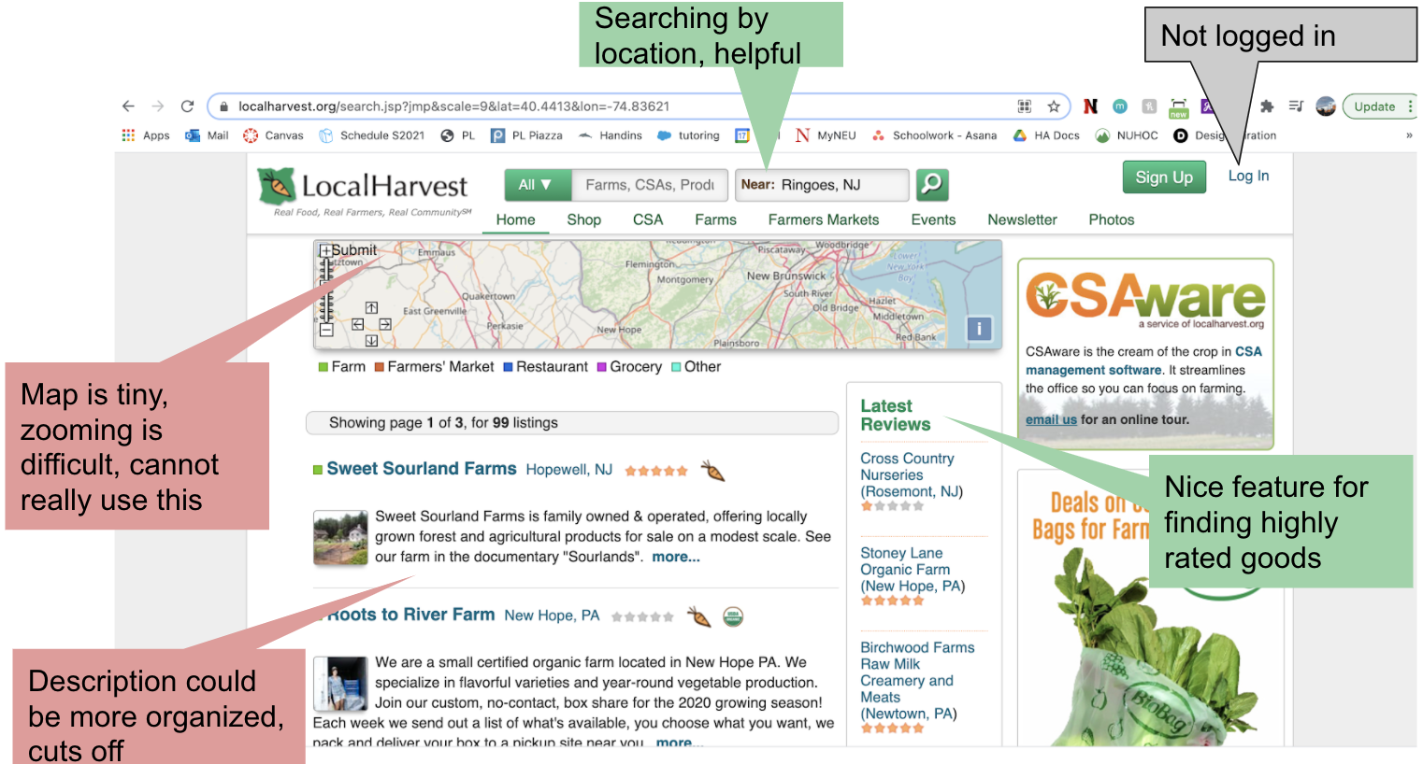
The Process - Benchmarking
LocalHarvest:
Robust searching system
Results could be cleaner

Slide 12
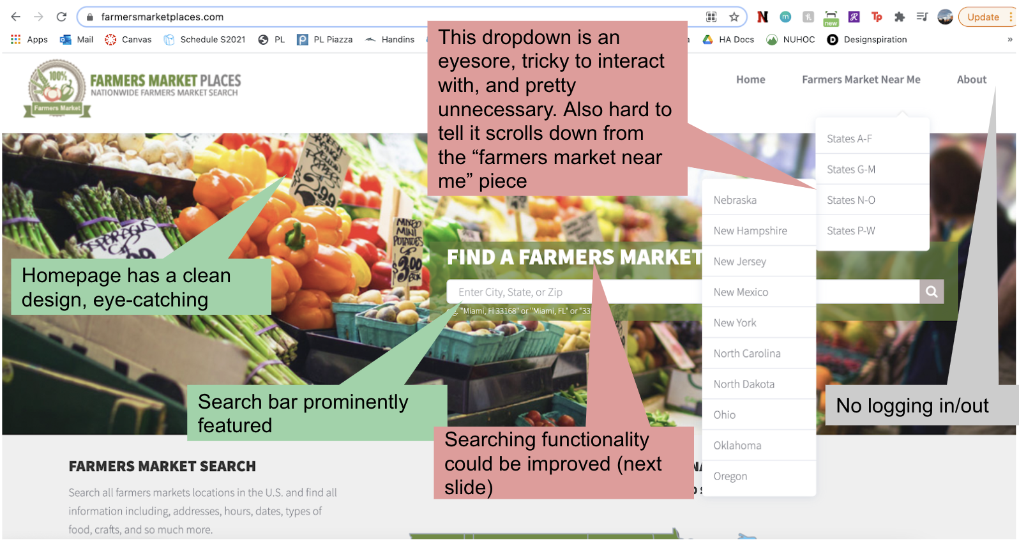
The Process - Benchmarking
FarmersMarketPlaces:
Searching could be improved
Visually interesting homepage

Slide 13
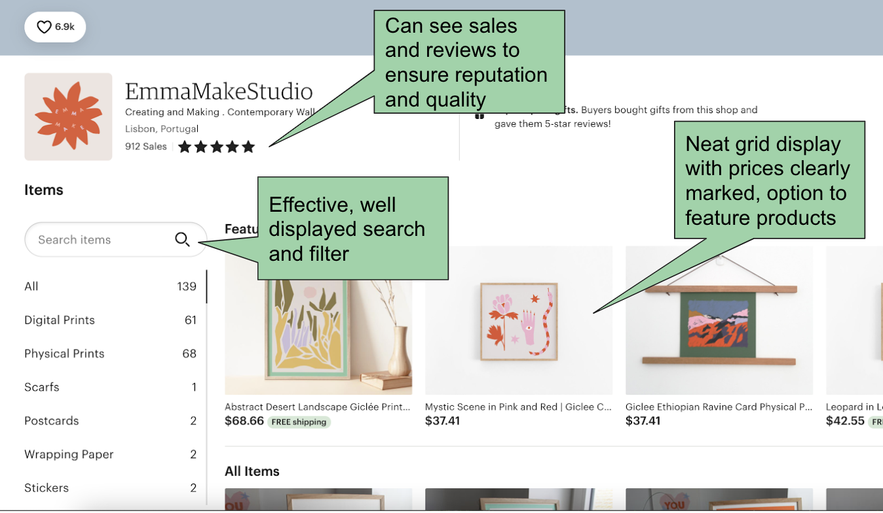
The Process - Benchmarking
Etsy:
Clean storefront design
Necessary information included

Slide 14
The Proposal
“For people interested in shopping at local/eco-friendly businesses who are looking to get fresh produce and other goods, FarmFresh is a resource that is tailored towards finding products from small, local businesses rather than large companies. Unlike Facebook Marketplace, FarmFresh has a UI designed to find in-season, locally available produce and other goods.”

Slide 15
Workflow #1
Buyer - Find a farm stand near you

Slide 16
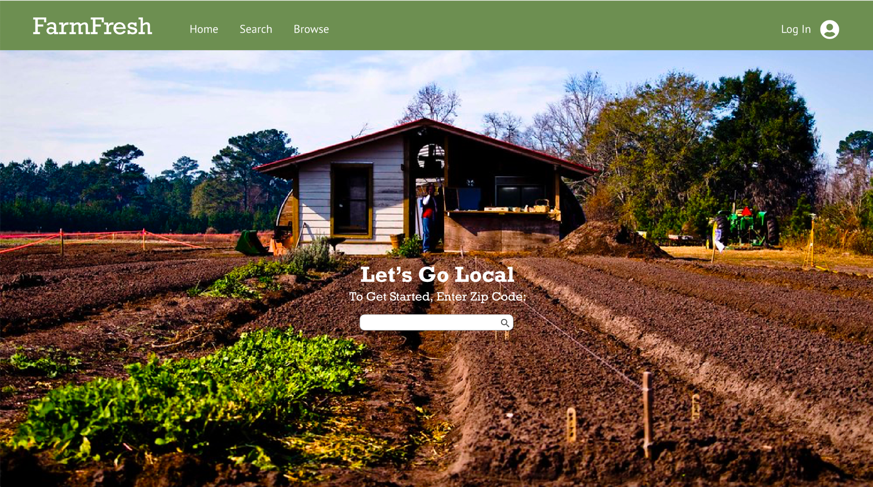

Slide 17
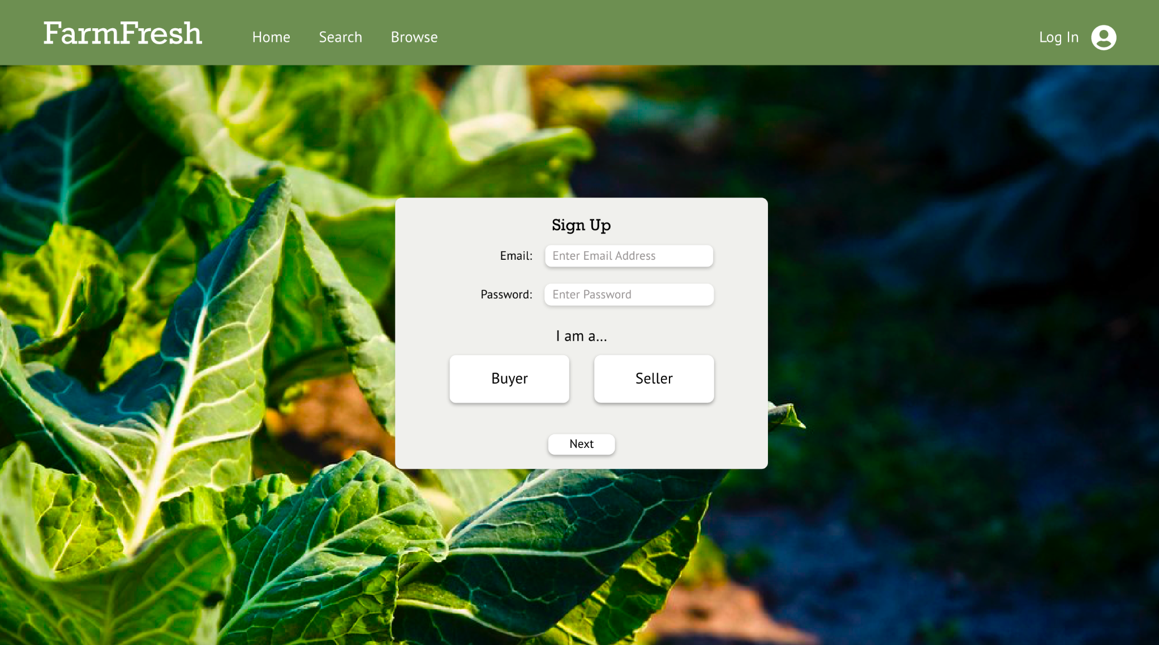

Slide 18
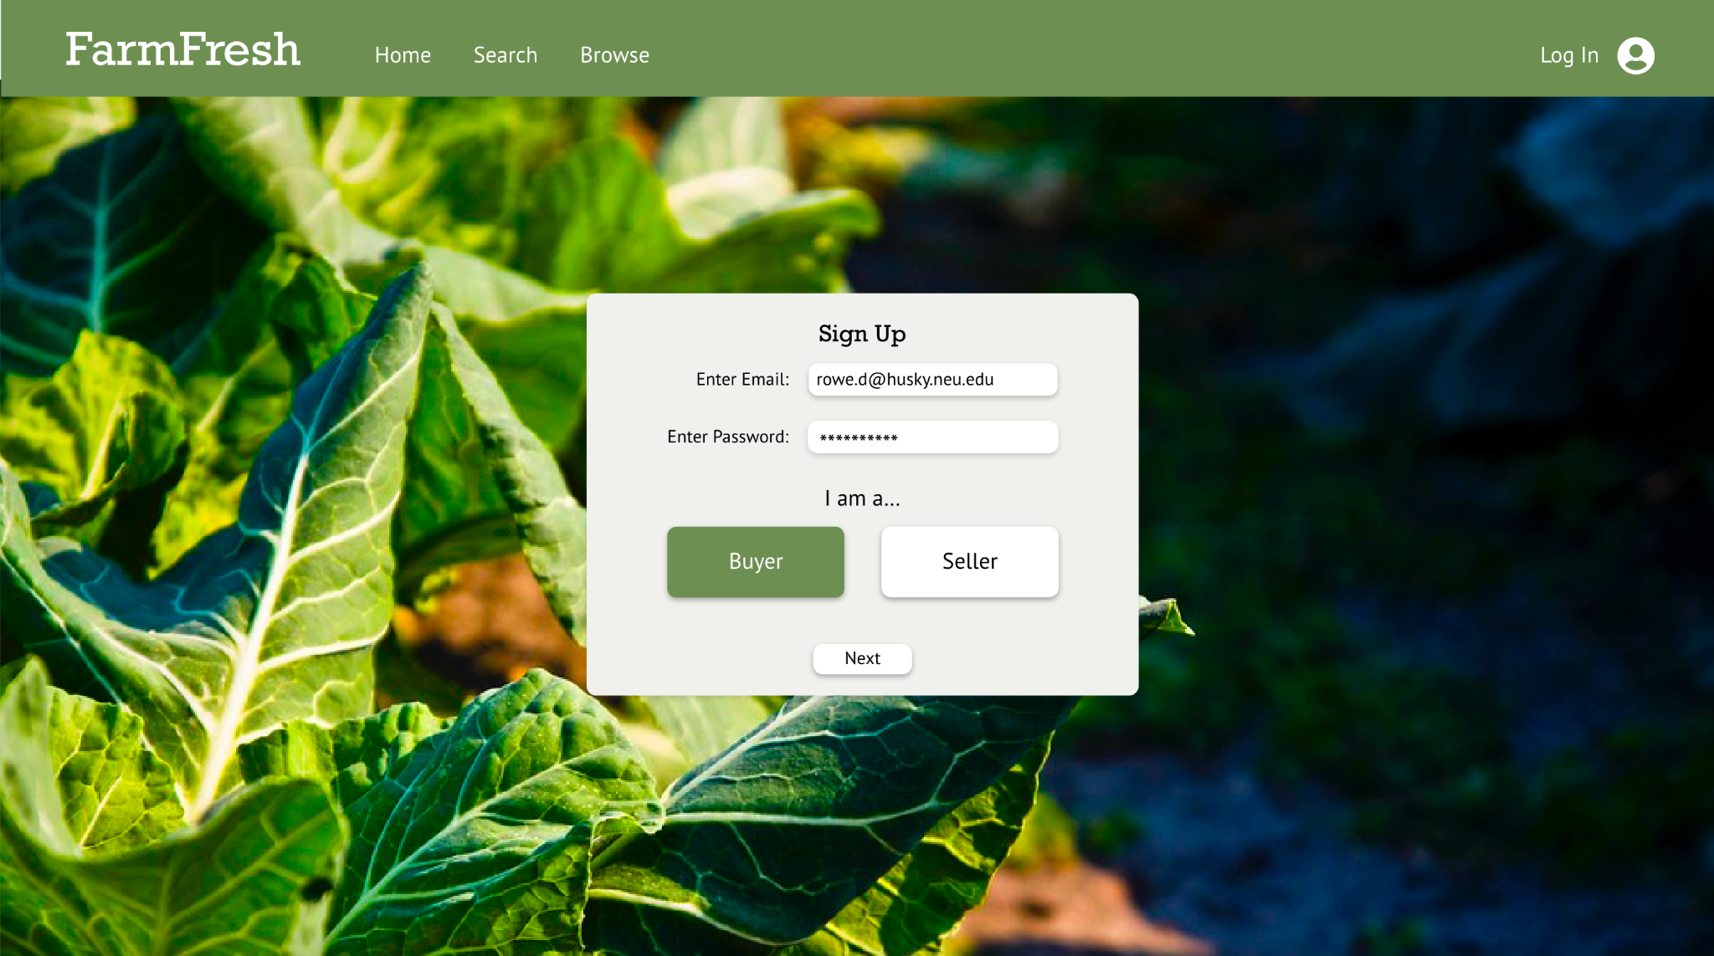

Slide 19


Slide 20


Slide 21
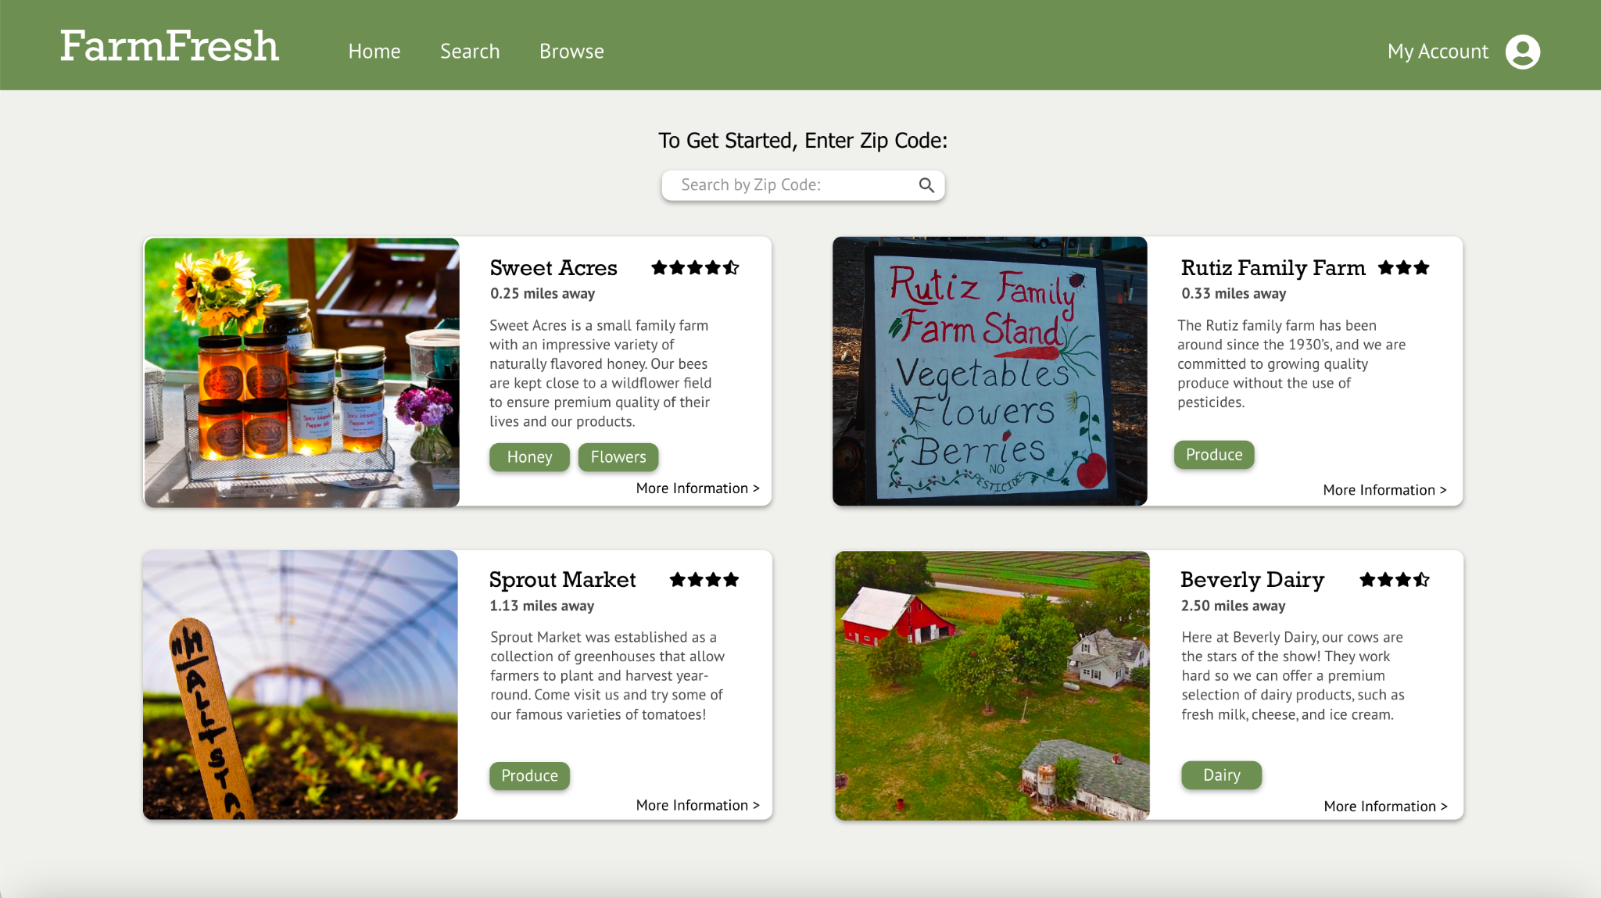

Slide 22
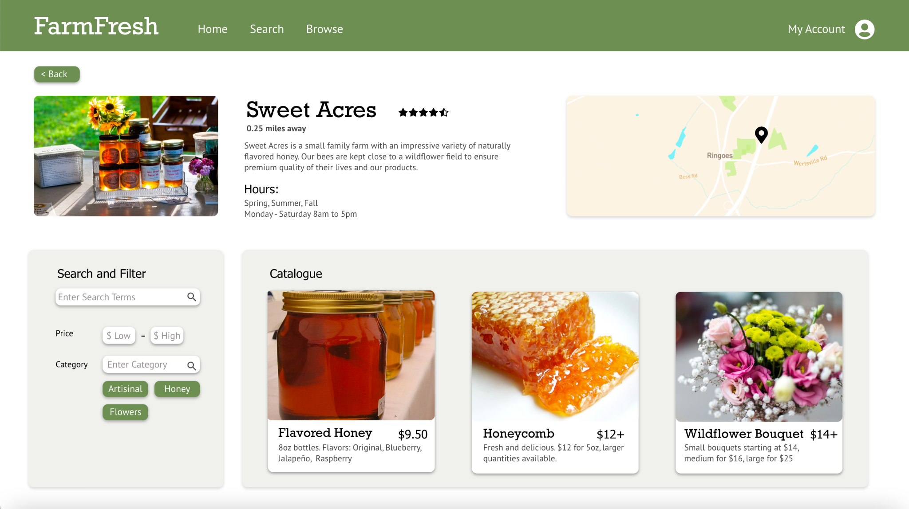

Slide 23
Workflow #2
Seller - Create your own stand

Slide 24


Slide 25
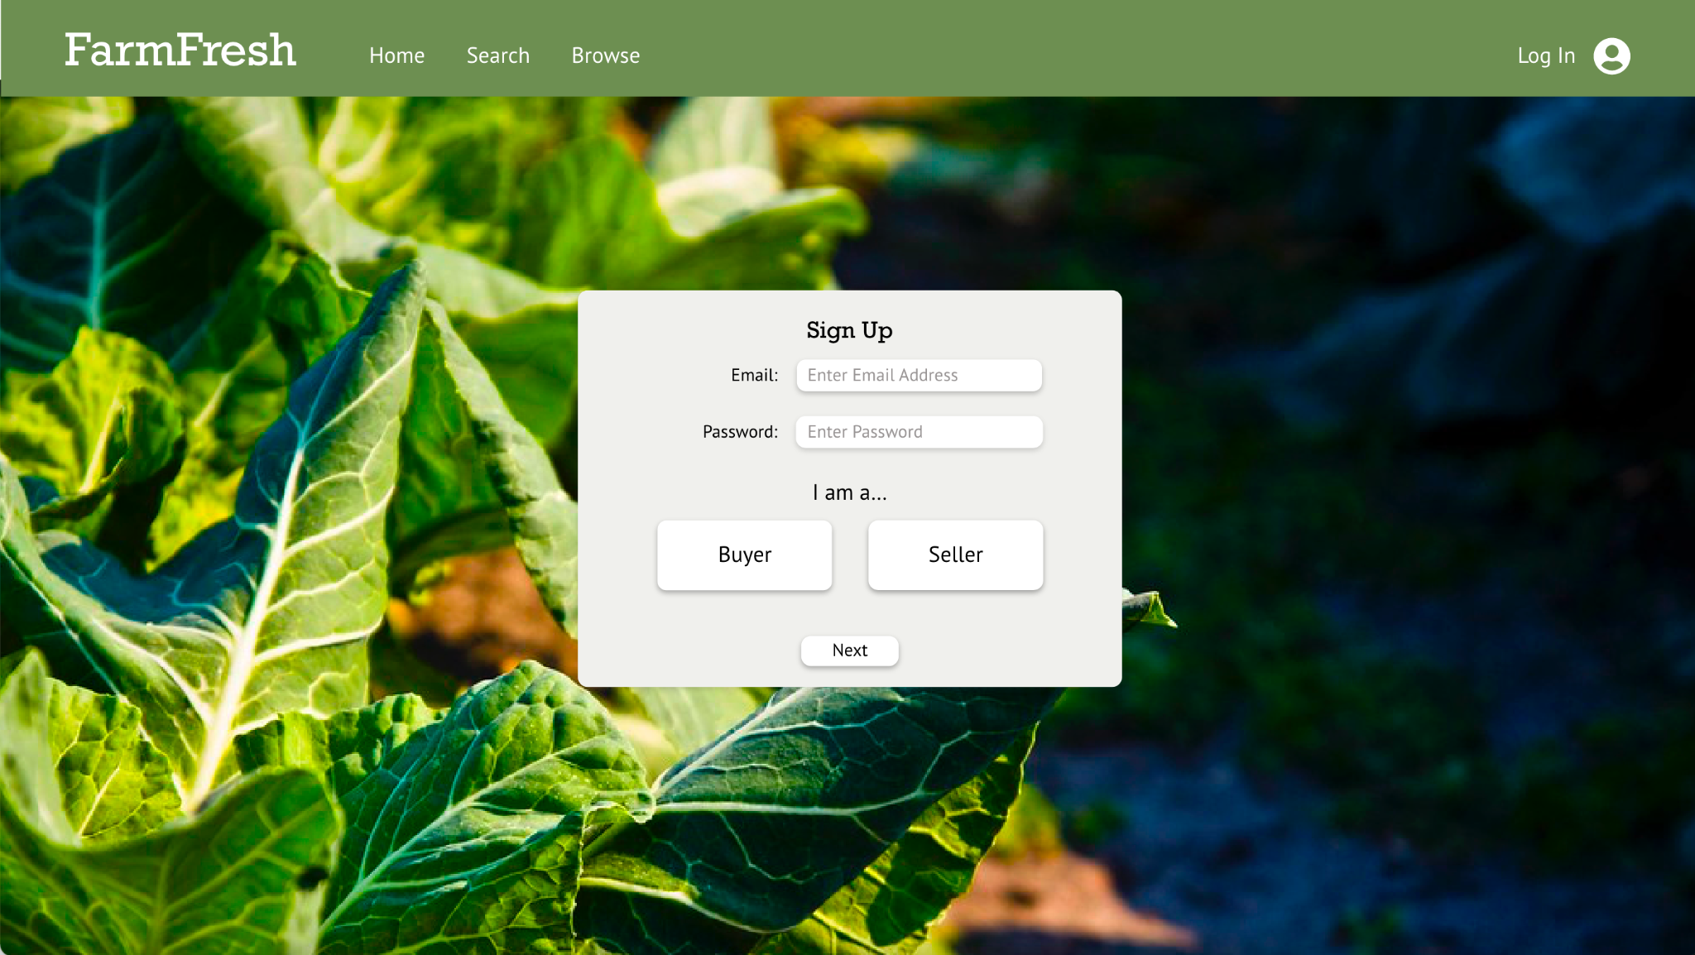

Slide 26


Slide 27
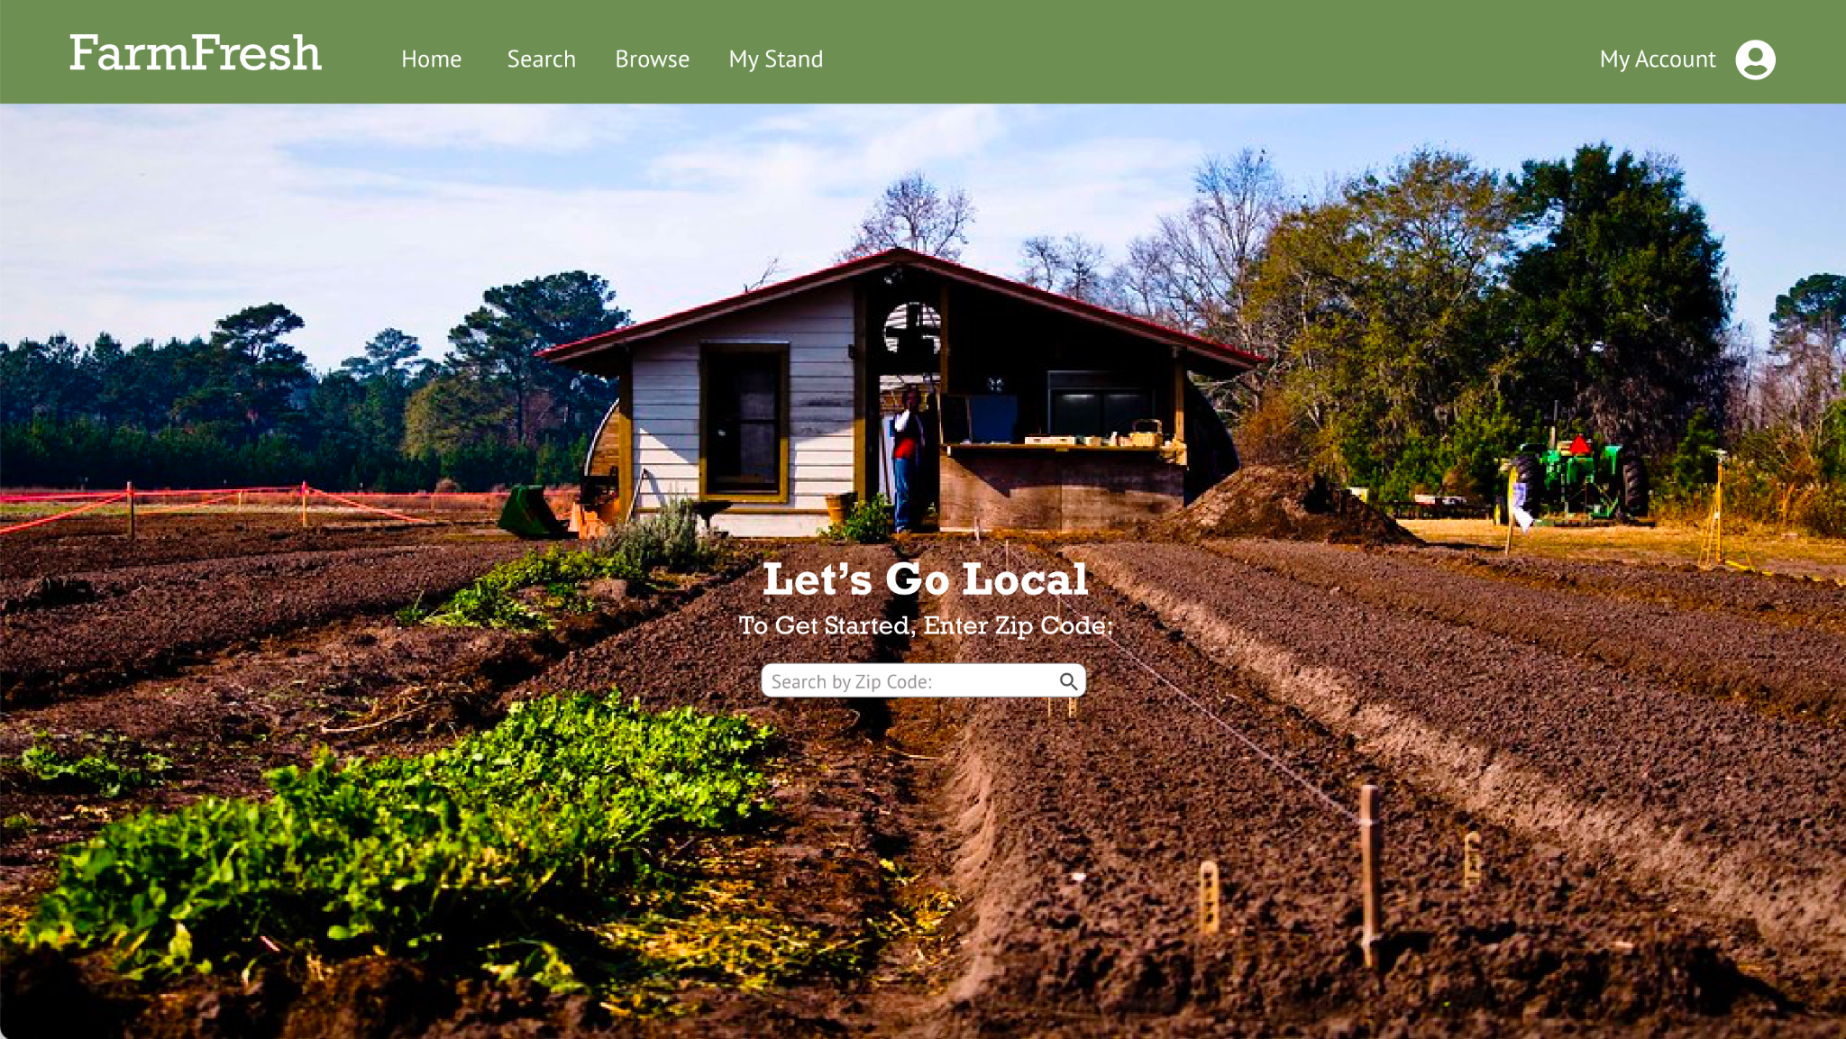

Slide 28
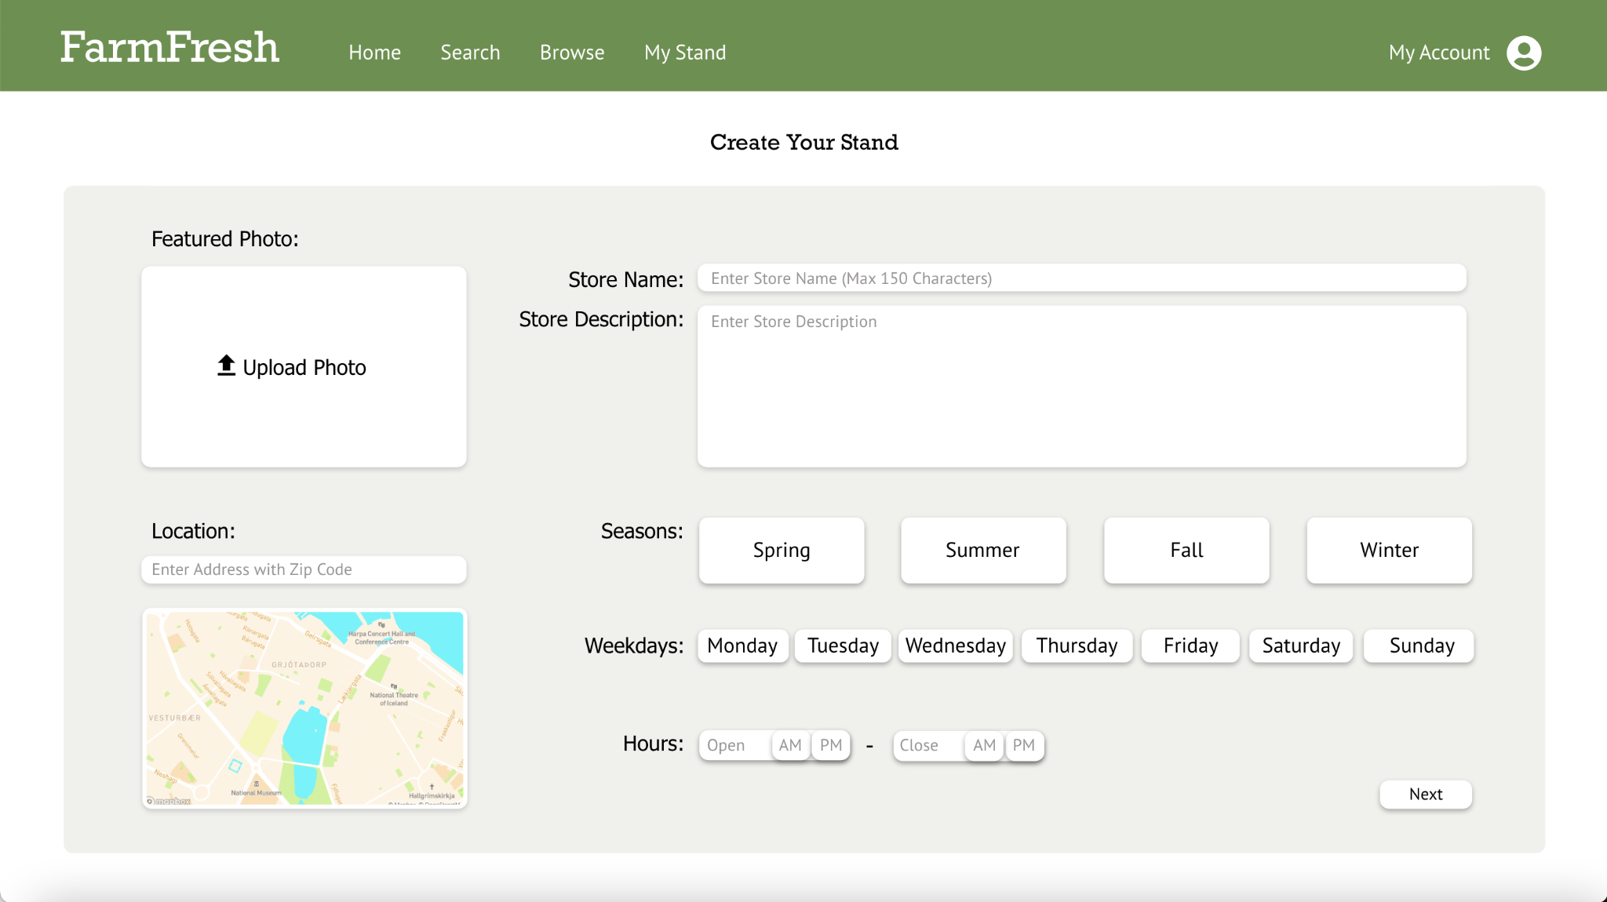

Slide 29
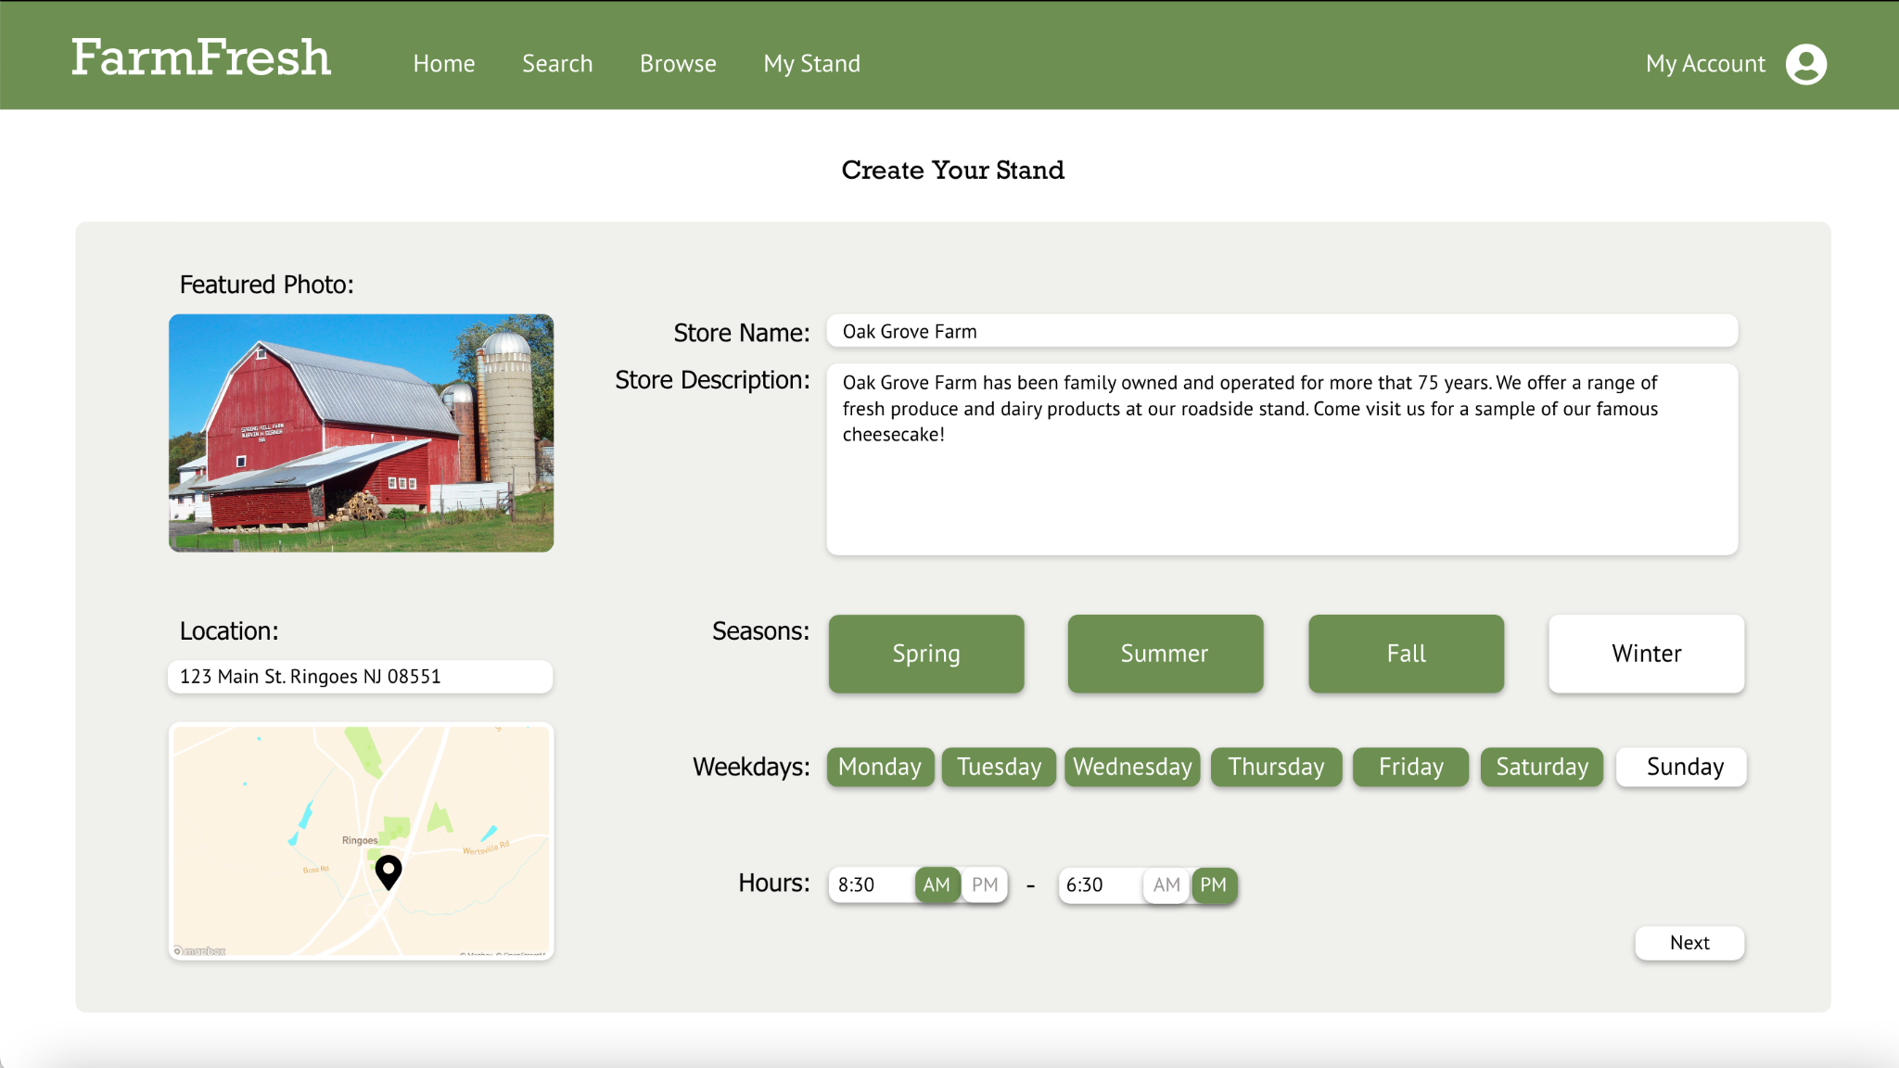

Slide 30
